Slide 1



AI VOICE ASSISTANT
PREPARED BY: GUIDED BY: DEPT:
HENA KHARWA (20CE043) DHAVALKUMAR BHOI SIR COMPUTER ENGINEERING
HIMANI KAPADIA (20CE041)

Slide 2

01
PROJECT DESCRIPTION
02
PRE-REQUESITES
FEATURES
03
IMPLEMENTATION ENVIRONMENT
04
TABLE OF CONTENTS
05
ARCHITECTURE
FLOWCHART
06
REFERENCES
07
LIVE DEMO

Slide 3
PROJECT DESCRIPTION
An intelligent virtual assistant (IVA) or intelligent personal assistant (IPA) is a software agent that can perform tasks or services for an individual based on commands or questions.
As soon as the assistant is turned on , it greets the user as per the time along with the date and then starts accepting and responding to the commands requested by the user.
The assistant works at a basic level unlike other assistants such as alexa, siri ,etc.
It also involves working with various modules of python and the concept of Artificial Intelligence.
It works on the concept of Artificial Narrow Intelligence.

Slide 4
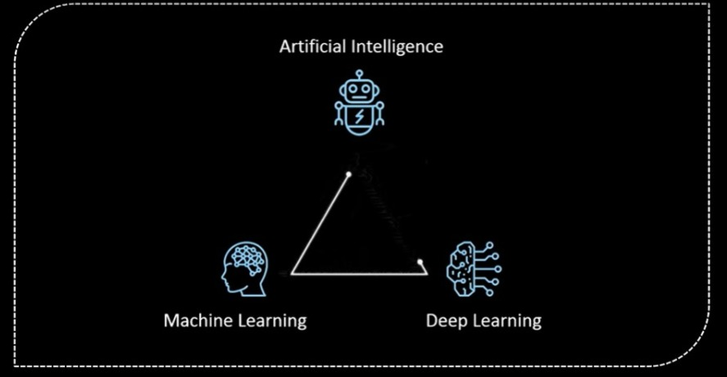
PRE-REQUESITES
WHAT IS ARTIFICIAL INTELLIGENCE?
Artificial Intelligence is a technique of getting machines to work and behave like humans.
For example: healthcare, marketing, business analytics, robotics etc.
The concept of Artificial Intelligence was discovered by John McCarthy.
Artificial intelligence refers to systems or machines that mimic human intelligence to perform tasks and can iteratively improve themselves based on the information they collect.

Slide 5
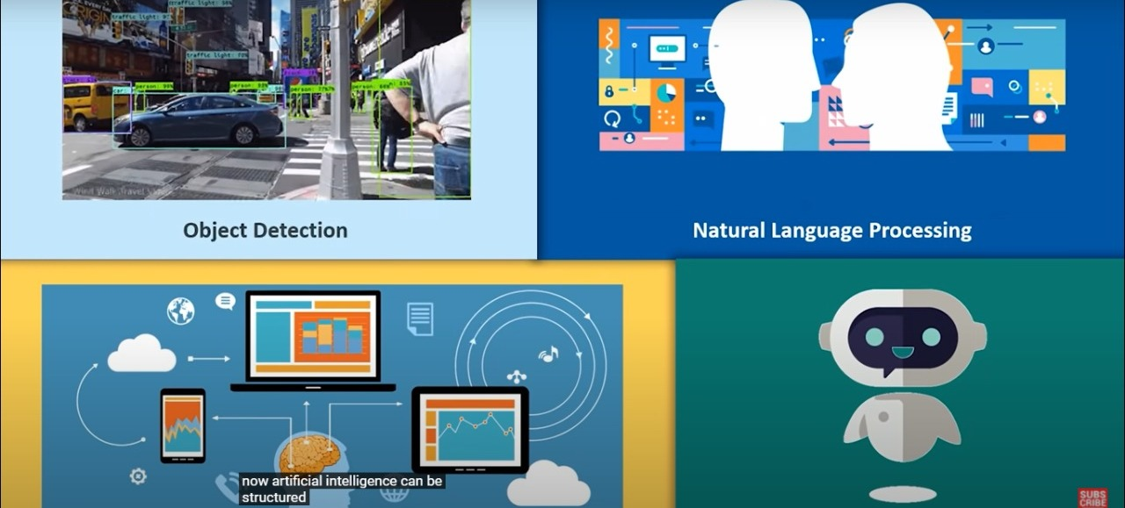
PRE-REQUESITES

Slide 6
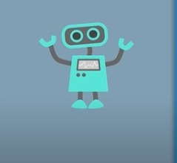


PRE-REQUESITES
TYPES OF ARTIFICIAL INTELLIGENCE:
Artificial Narrow Intelligence Artificial General Intelligence Artificial Super Intelligence

Slide 7
OVERALL FEATURES
Speed Test Calculator
Telling Temperature
Working with Translator
Setting an alarm
Taking a snapshot
Creating a to-do-list
Sending a email
Playing movies
Find my location
Download a video
Setting a reminder
CPU and Battery
Converting text to handwritten
Switching among the assistant with change of voice
Surfing on Wikipedia
Opening an Application
Opening an Web Browser
Opening an Website
Playing songs
Playing video on Youtube
Working with Dictionary
Working with Calculator
Telling a joke

Slide 8
IMPLEMENTED FEATURES
DATE AND TIME: Tells us current date and time
YOUTUBE SEARCH: Searches for your request query on Youtube
GOOGLE SEARCH: Searches for your requested query on Google
WIKIPEDIA: Searches for your requested query on Wikipedia and tells you
PLAY MUSIC: Plays music from your downloads section if downloaded else plays it from Youtube

Slide 9
IMPLEMENTED FEATURES
TAKE A SCREENSHOT: Takes a Screenshot and shows the folder in which it is saved
OPEN SOCIAL MEDIA APPS: Opens few pre-defined social media application
YOUTUBE AUTOMATION: It can play,pause,skip,resume,mute ,full screen,next video,previous video,turn on/off caption from youtube.
CHROME AUTOMATION: It can perform open new tab,close tab,open new window,open incognito mode,show history,show downloads,open task manager,clear brow history,help center,make bookmark, reopen last 10 tabs that you closed earlier in google chrome
TELLING A JOKE: Tells us any joke

Slide 10
IMPLEMENTATION ENVIRONMENT
SOFTWARE REQUIREMENTS: VS CODE
LANGUAGES: PYTHON AND AI BASED CONCEPTS
MODULES: pyttsx3 pyautogui
speech recognition Datetime
Webbrowser Keyboard
Pywhatkit Pyjokes
Wikipedia
OS

Slide 11
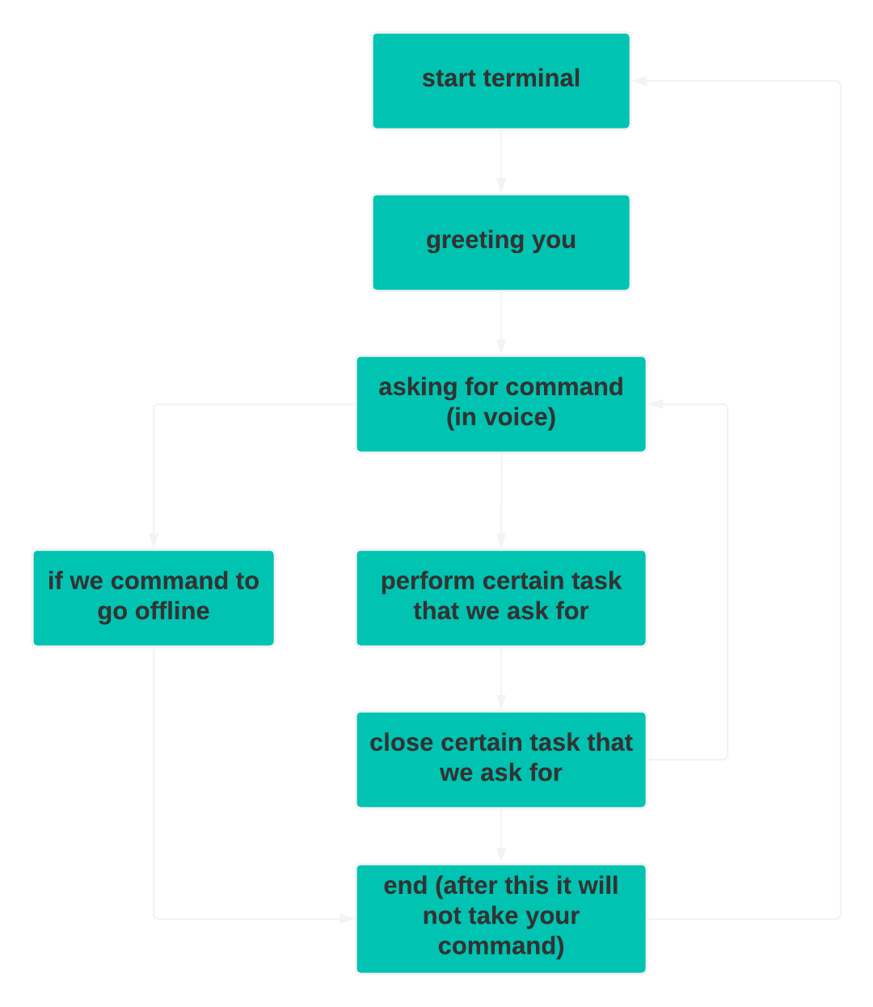
ARCHITECUTURE FLOWCHART

Slide 12
REFERENCES
Udemy Links (Only for Reference):
https://www.udemy.com/course/learn-to-create-advance-ai-assistant-jarvis-20with-python/
https://www.udemy.com/course/jarvis-ai/
Reference Article Links:
https://www.sciencedirect.com/science/article/pii/S0969698920312911
https://files.eric.ed.gov/fulltext/EJ1267812.pdf

Slide 13
LET US HAVE A LOOK AT LIVE DEMO!!

